Slide 1

Customer Segmentation Analysis

Slide 2
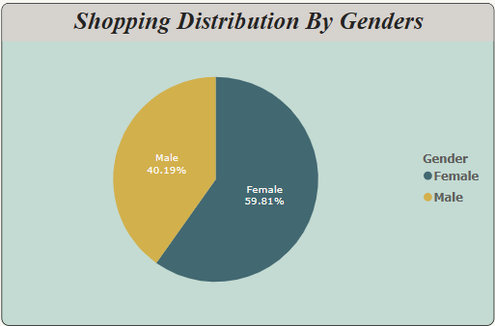
1) How is the Shopping Distribution according to Genders?

Slide 3
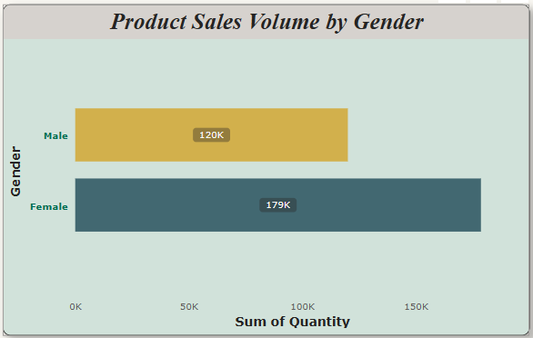
2) Which gender did we sell more products to?

Slide 4
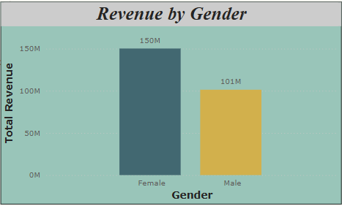
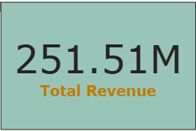
3) Which gender generated more revenue?

Slide 5
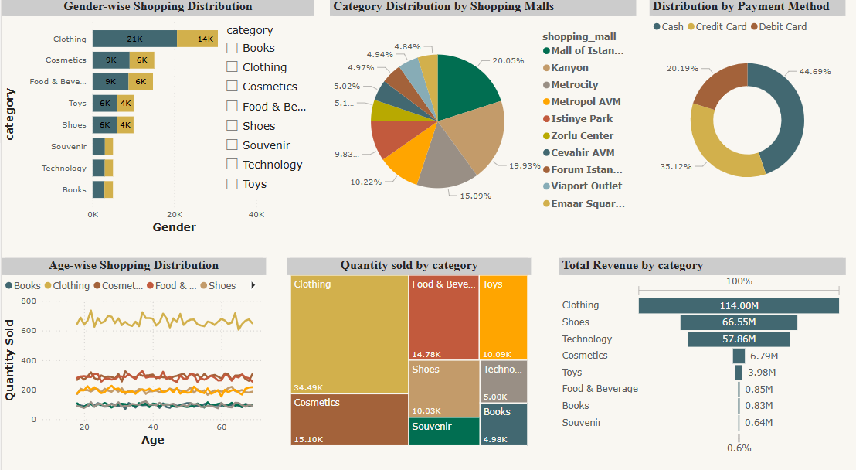
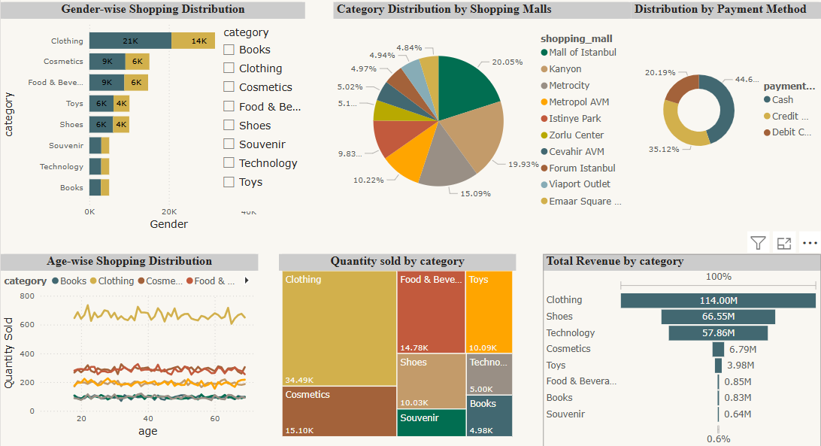
4) Distribution of purchase categories relative to other columns?

Slide 6
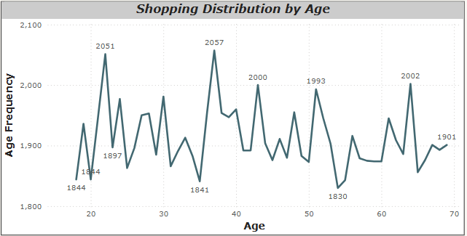
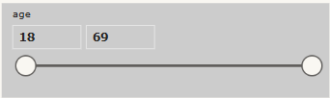
5) How is the shopping distribution according to age?

Slide 7
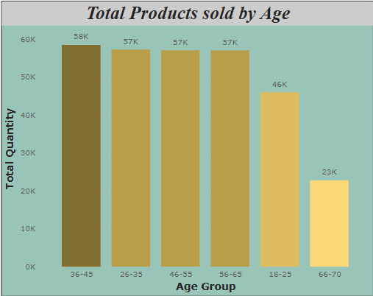
6) Which age category did we sell more products to?

Slide 8
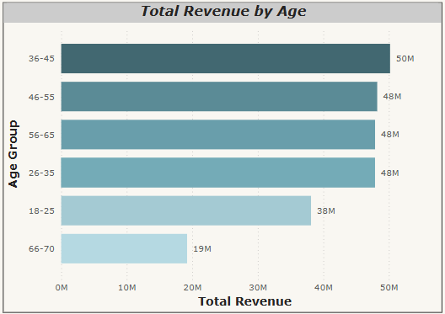
7) Which age category generated more revenue?

Slide 9
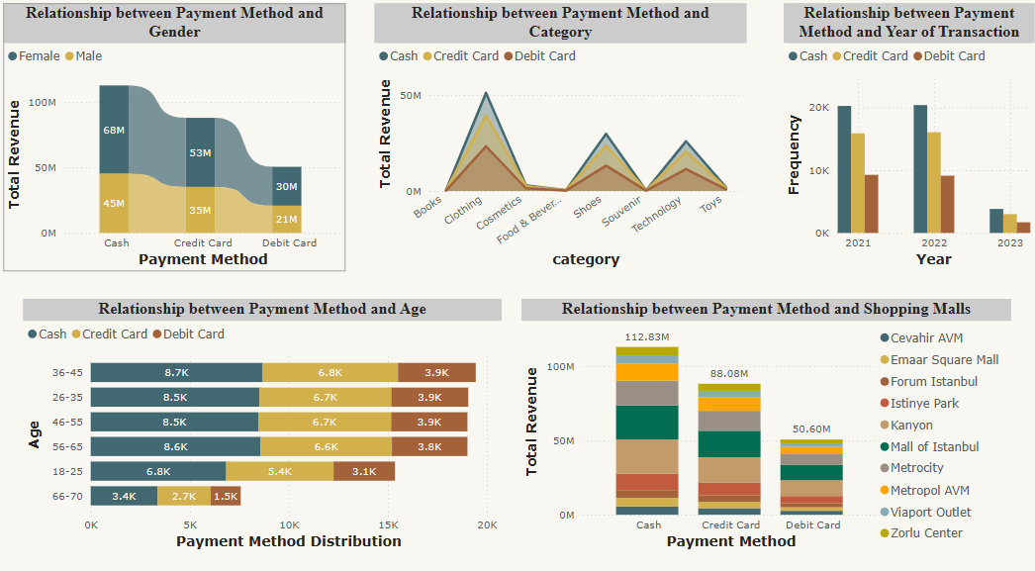
8) Does the payment method have a relation with other columns?

Slide 10
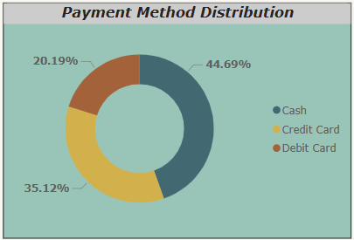
10) How is the distribution of the payment method?

